Slide 1
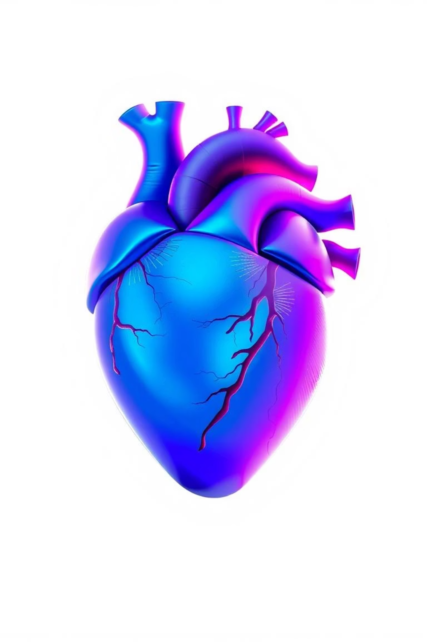
The Human Heart: A Fun & Easy Guide
Discover the amazing organ that keeps us going!

Slide 2
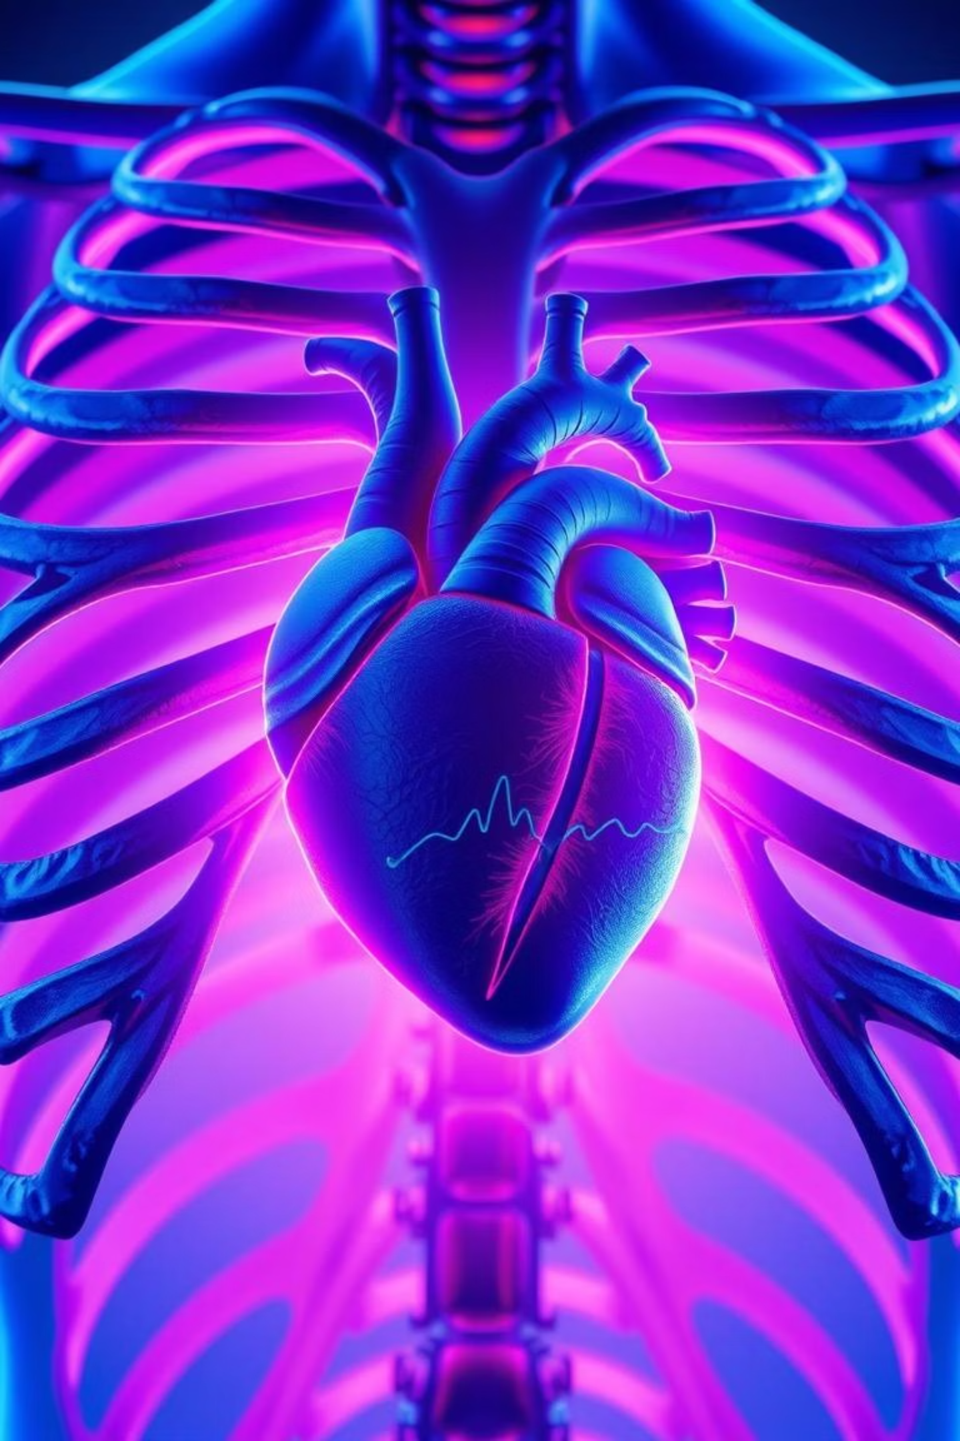
Chapter 1
What is the Heart?
The heart is a powerful muscular organ, about the size of your fist, located slightly to the left side of your chest. Its primary job is to pump blood throughout your entire body, ensuring every part receives what it needs to function.

Slide 3

Chapter 2
Structure of the Heart: Four Chambers
1
2
Right Atrium
Right Ventricle
Receives blood rich in carbon dioxide from the body.
Pumps this carbon dioxide-rich blood to the lungs.
3
4
Left Atrium
Left Ventricle
Receives oxygen-rich blood returning from the lungs.
Pumps oxygen-rich blood to the entire body.

Slide 4
Chapter 3
How Does the Heart Work?
Think of your heart as a tireless pump, working in a continuous cycle to keep blood flowing.
01
02
Deoxygenated Blood In
To the Lungs
Blood without oxygen enters the right side of the heart.
The heart sends this blood to the lungs to pick up oxygen.
03
04
Oxygenated Blood Back
To the Body
Oxygen-rich blood returns to the left side of the heart.
The heart then pumps this fresh blood to your entire body through arteries.

Slide 5

An Incredible Machine
100,000
Beats a Day
Your heart beats approximately 100,000 times every single day!

Slide 6
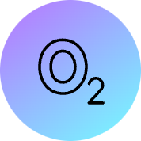

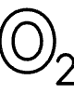





Chapter 4
Why is the Heart Important?
The heart is vital for life, performing critical functions that keep every cell in your body thriving.
Supplies Oxygen
Provides Nutrients
Delivers essential oxygen to all body parts.
Carries vital nutrients wherever they're needed.
Removes Waste
Keeps Us Alive
Efficiently removes waste products like carbon dioxide.
Ensures our overall health and survival.

Slide 7
Chapter 5
How to Keep Your Heart Healthy
Taking care of your heart is simple and makes a big difference!
Eat Well
Stay Active
Fruits
Daily Exercise
Vegetables
Running
Whole Grains
Swimming
Playing

Slide 8

Healthy Habits for a Happy Heart
Avoid Junk Food
Hydrate
Limit processed foods and excessive sugar intake.
Drink plenty of water throughout the day.

Slide 9
Key Takeaways
The Heart is a Pump
Four Chambers
A muscular organ that circulates blood, delivering oxygen and nutrients.
Each chamber plays a specific role in the blood's journey through the body.
Constant Work
Healthy Choices Matter
Beats tirelessly, about 100,000 times a day, to keep us alive.
Diet and exercise are crucial for maintaining a strong heart.

Slide 10

Thank You!
Remember to take care of your amazing heart every day.

